Slide 1
Programming With C++/R
DST102TC
Huakang Li
Huakang.li@xjtlu.edu.cn
School of AI and Advanced Computing
Notes:
English Title: Uppercase, Calibri size 60, XJTLU Navy
English Subtitle: Uppercase, Calibri size 36, XJTLU Navy

Slide 2
Chapter 11
Pointer and Dynamic Memory Management
Notes:
English Title: Uppercase, Calibri size 60, XJTLU Navy
English Subtitle: Uppercase, Calibri size 36, XJTLU Navy

Slide 3
Objectives
To describe what a pointer is (§11.1).
To learn how to declare a pointer and assign a memory address to it (§11.2).
To access values via pointers (§11.2).
To define synonymous types using the typedef keyword (§11.3).
To declare constant pointers and constant data (§11.4).
To explore the relationship between arrays and pointers (§11.5).
To access array elements using pointers (§11.6).
To pass pointer arguments to a function (§11.7).
To learn how to return a pointer from a function (§11.8).
To use the new operator to create dynamic arrays (§11.9).
To create objects dynamically and access objects via pointers (§11.10).
To reference the calling object using the this pointer (§11.11).
To implement the destructor for performing customized operations (§11.12).
To design a class for students registering courses (§11.13).
To create an object using the copy constructor that copies data from another object of the same type (§11.14).
To customize the copy constructor for performing a deep copy (§11.15).

Slide 4
What is a Pointer?
Pointer variables, simply called pointers, are designed to hold memory addresses as their values.
Normally, a variable contains a specific value, e.g., an integer, a floating-point value, and a character.
However, a pointer contains the memory address of a variable that in turn contains a specific value.

Slide 5
What is a Pointer?

Slide 6
Declare a Pointer
Like any other variables, pointers must be declared before they can be used. To declare a pointer, use the following syntax:
dataType* pVarName;
Each variable being declared as a pointer must be preceded by an asterisk (*). For example, the following statement declares a pointer variable named pCount that can point to an int varaible.
int* pCount;

Slide 7
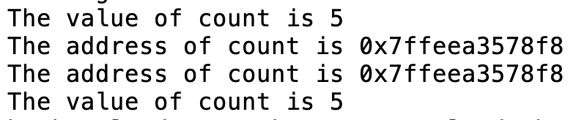
TestPointer.cpp
#include <iostream>
using namespace std;
int main()
{
int count = 5;
int* pCount = &count;
cout << "The value of count is " << count << endl;
cout << "The address of count is " << &count << endl;
cout << "The address of count is " << pCount << endl;
cout << "The value of count is " << *pCount << endl;
return 0;
}

Slide 8
Dereferencing
Referencing a value through a pointer is called indirection. The syntax for referencing a value from a pointer is
*pointer
For example, you can increase count using
count++; // direct reference, increment the value in count by 1
or
(*pCount)++; // indirect reference, the value in the memory pointed by pCount is incremented by 1

Slide 9
Pointer Type
A pointer variable is declared with a type such as int, double, etc. You have to assign the address of the variable of the same type. It is a syntax error if the type of the variable does not match the type of the pointer.
For example, the following code is wrong.
int area = 1;
double* pArea = &area; // Wrong

Slide 10
Initializing Pointer
Like a local variable, a local pointer is assigned an arbitrary value if you don’t initialize it.
A pointer may be initialized to 0, which is a special value for a pointer to indicate that the pointer points to nothing.
You should always initialize pointers to prevent errors. Dereferencing a pointer that is not initialized could cause fatal runtime error or it could accidentally modify important data.

Slide 11
Caution
You can declare two variables on the same line. For example, the following line declares two int variables:
int i = 0, j = 1;
Can you declare two pointer variables on the same line as follows?
int* pI, pJ;
No, this line is equivalent to
int *pI, pJ;

Slide 12
typedef
A synonymous type can be defined using the typedef keyword.
Syntax:
typedef existingType newType;
Example:
typedef int integer;
typedef int* intPointer;
integer value = 40;
intPointer p1, p2; // This declares two pointers of int type.

Slide 13
nullptr
A pointer may be initialized to 0, which is a special value to indicate that the pointer points to nothing.
To prevent errors, you should always initialize pointers.
A number of C++ libraries including <iostream> define NULL as a constant with value 0. It is more descriptive to use NULL than 0.
C++11 introduced a new keyword nullptr for null pointer. Using nullptr is better than using NULL, because NULL may be accidentally redefined in the program.
C++11: The keyword nulptr is defined in C++11

Slide 14
Effect of Assignment =
Suppose pX and pY are two pointer variables for variables x and y, as shown in Figure 11.3. To understand the relationships between the variables and their pointers, let us examine the effect of assigning pY to pX and *pY to *pX.

Slide 15
Effect of Assignment =

Slide 16
Using const with Pointers
You learned how to declare a constant using the const keyword. A constant cannot be changed once it is declared. You can declare a constant pointer. For example, see the following code:
double radius = 5;
double* const pValue = &radius;

Slide 17
Arrays and Pointers
An array variable without a bracket and a subscript actually represents the starting address of the array. In this sense, an array variable is essentially a pointer. Suppose you declare an array of int value as follows:
int list[6] = {11, 12, 13, 14, 15, 16};

Slide 18
Array Pointer
*(list + 1) is different from *list + 1. The dereference operator (*) has precedence over +. So, *list + 1 adds 1 to the value of the first element in the array, while *(list + 1) dereference the element at address (list + 1) in the array.

Slide 19
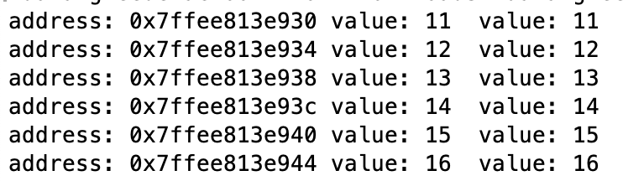
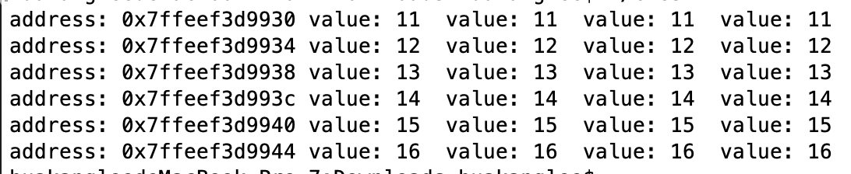
ArrayPointer.cpp
PointerWithIndex.cpp
#include <iostream>
using namespace std;
int main()
{
int list[6] = {11, 12, 13, 14, 15, 16};
for (int i = 0; i < 6; i++)
cout << "address: " << (list + i) <<
" value: " << *(list + i) << " " <<
" value: " << list[i] << endl;
return 0;
}
#include <iostream>
using namespace std;
int main()
{
int list[6] = {11, 12, 13, 14, 15, 16};
int* p = list;
for (int i = 0; i < 6; i++)
cout << "address: " << (list + i) <<
" value: " << *(list + i) << " " <<
" value: " << list[i] << " " <<
" value: " << *(p + i) << " " <<
" value: " << p[i] << endl;
return 0;
}

Slide 20
Passing Pointer Arguments
A pointer argument can be passed by value or by reference. For example, you can define a function as follows:
void f(int* p1, int* &p2)
which is equivalently to
typedef int* intPointer;
void f(intPointer p1, intPointer& p2)
Here p1 is pass-by-value and p2 is pass-by-reference.

Slide 21
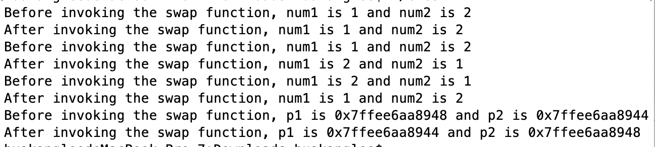
TestPointerArgument.cpp
int main()
{
// Declare and initialize variables
int num1 = 1;
int num2 = 2;
cout << "Before invoking the swap function, num1 is "
<< num1 << " and num2 is " << num2 << endl;
// Invoke the swap function to attempt to swap two variables
swap1(num1, num2);
cout << "After invoking the swap function, num1 is " << num1 <<
" and num2 is " << num2 << endl;
cout << "Before invoking the swap function, num1 is "
<< num1 << " and num2 is " << num2 << endl;
// Invoke the swap function to attempt to swap two variables
swap2(num1, num2);
cout << "After invoking the swap function, num1 is " << num1 <<
" and num2 is " << num2 << endl;
cout << "Before invoking the swap function, num1 is "
<< num1 << " and num2 is " << num2 << endl;
// Invoke the swap function to attempt to swap two variables
swap3(&num1, &num2);
cout << "After invoking the swap function, num1 is " << num1 <<
" and num2 is " << num2 << endl;
int* p1 = &num1;
int* p2 = &num2;
cout << "Before invoking the swap function, p1 is "
<< p1 << " and p2 is " << p2 << endl;
// Invoke the swap function to attempt to swap two variables
swap4(p1, p2);
cout << "After invoking the swap function, p1 is " << p1 <<
" and p2 is " << p2 << endl;
return 0;
}
#include <iostream>
using namespace std;
// Swap two variables using pass-by-value
void swap1(int n1, int n2){
int temp = n1;
n1 = n2;
n2 = temp;
}
// Swap two variables using pass-by-reference
void swap2(int& n1, int& n2){
int temp = n1;
n1 = n2;
n2 = temp;
}
// Pass two pointers by value
void swap3(int* p1, int* p2){
int temp = *p1;
*p1 = *p2;
*p2 = temp;
}
// Pass two pointers by reference
void swap4(int* &p1, int* &p2){
int* temp = p1;
p1 = p2;
p2 = temp;
}

Slide 22
array parameter or pointer parameter

Slide 23
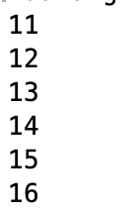
const parameter
If an object value does not change, you should declare it const to prevent it from being modified accidentally.
ConstParameter.cpp
#include <iostream>
using namespace std;
void printArray(const int*, const int);
int main()
{
int list[6] = {11, 12, 13, 14, 15, 16};
printArray(list, 6);
return 0;
}
void printArray(const int* list, const int size)
{
for (int i = 0; i < size; i++)
cout << list[i] << " "<<endl;
}

Slide 24

Returning a Pointer from Functions
You can use pointers as parameters in a function. Can you return a pointer from a function? The answer is yes.
ReverseArrayUsingPointer.cpp
#include <iostream>
using namespace std;
int* reverse(int* list, int size)
{
for (int i = 0, j = size - 1; i < j; i++, j--)
{
// Swap list[i] with list[j]
int temp = list[j];
list[j] = list[i];
list[i] = temp;
}
return list;
}
void printArray(const int* list, int size)
{
for (int i = 0; i < size; i++)
cout << list[i] << " "<<endl;
}
int main()
{
int list[] = {1, 2, 3, 4, 5, 6};
int* p = reverse(list, 6);
printArray(p, 6);
return 0;
}

Slide 25
Useful Array Functions
C++ provides several functions for manipulating arrays. You can use the min_element and max_element functions to return the pointer to the minimal and maximal element in an array, the sort function to sort an array, the random_shuffle function to randomly shuffle an array, and the find function to find an element in an array. All these functions use pointers in the arguments.

Slide 26
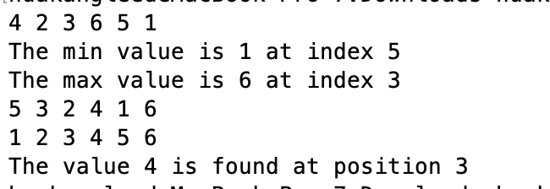
UsefulArrayFunctions.cpp
int main()
{
int list[] = {4, 2, 3, 6, 5, 1};
printArray(list, 6);
int* min = min_element(list, list + 6);
int* max = max_element(list, list + 6);
cout << "The min value is " << *min << " at index "
<< (min - list) << endl;
cout << "The max value is " << *max << " at index "
<< (max - list) << endl;
random_shuffle(list, list + 6);
printArray(list, 6);
sort(list, list + 6);
printArray(list, 6);
int key = 4;
int* p = find(list, list + 6, key);
if (p != list + 6)
cout << "The value " << *p << " is found at position "
<< (p - list) << endl;
else
cout << "The value " << key << " is not found" << endl;
return 0;
}
#include <iostream>
#include <algorithm>
using namespace std;
void printArray(const int* list, int size)
{
for (int i = 0; i < size; i++)
cout << list[i] << " ";
cout << endl;
}

Slide 27
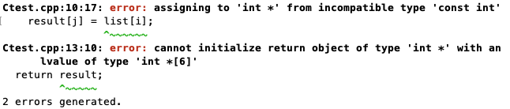
Why Do We Need Dynamic Memory Allocation?
WrongReverse.cpp
#include <iostream>
using namespace std;
int* reverse(const int* list, int size){
int result[6];
for (int i = 0, j = size - 1; i < size; i++, j--)
{
result[j] = list[i];
}
return result;
}
void printArray(const int* list, int size){
for (int i = 0; i < size; i++)
cout << list[i] << " ";
}
int main(){
int list[] = {1, 2, 3, 4, 5, 6};
int* p = reverse(list, 6);
printArray(p, 6);
return 0;
}
#include <iostream>
using namespace std;
int* reverse(const int* list, int size){
int* result = new int[size];
for (int i = 0, j = size - 1; i < size; i++, j--)
{
result[j] = list[i];
}
return result;
}
void printArray(const int* list, int size){
for (int i = 0; i < size; i++)
cout << list[i] << " ";
}
int main()
{
int list[] = {1, 2, 3, 4, 5, 6};
int* p = reverse(list, 6);
printArray(p, 6);
return 0;
}

Slide 28
Dynamic Memory Allocation
int* result = new int[6]; // Allocate
delete [] result; // Deallocate
int* p = new int; // Allocate
delete p; // Deallocate

Slide 29
Creating Dynamic Objects
You can also create objects dynamically on the heap using the following syntax:
ClassName* pObject = new ClassName(); or ClassName *pObject = new ClassName; or
ClassName* pObject = new ClassName(arguments);
// Create an object using the no-arg constructor
string* p = new string(); // or string* p = new string;
// Create an object using the constructor with arguments
string* p = new string("abcdedfg");

Slide 30
Accessing Dynamic Objects
To access object members via a pointer, you must dereference the pointer and use the dot (.) operator to object’s members. For example,
string* p = new string("abcdedfg");
cout << "The first three characters in the string are "
<< (*p).substr(0, 3) << endl;
cout << "The length of the string is " << (*p).length() << endl;

Slide 31
Accessing Dynamic Objects
C++ also provides a shorthand member selection operator for accessing object members from a pointer: arrow (->) operator, which is a dash (-) immediately followed by the greater than (>) symbol. For example,
cout << "The first three characters in the string are "
<< p->substr(0, 3) << endl;
cout << "The length of the string is " << p->length() << endl;

Slide 32
The this Pointer
Sometimes you need to reference a class’s hidden data field in a function. For example, a data field name is often used as the parameter name in a set function for the data field.
In this case, you need to reference the hidden data field name in the function in order to set a new value to it.
A hidden data field can be accessed by using the this keyword, which is a special built-in pointer that references to the calling object.

Slide 33
CircleWithThisPointerc.pp
#include "CircleWithPrivateDataFields.h" // Defined in Listing 9.9
// Construct a default circle object
Circle::Circle()
{
radius = 1;
}
// Construct a circle object
Circle::Circle(double radius)
{
this->radius = radius; // or (*this).radius = radius;
}
// Return the area of this circle
double Circle::getArea()
{
return radius * radius * 3.14159;
}
// Return the radius of this circle
double Circle::getRadius()
{
return radius;
}
// Set a new radius
void Circle::setRadius(double radius)
{
this->radius = (radius >= 0) ? radius : 0;
}

Slide 34
Destructors
Destructors are the opposite of constructors. A constructor is invoked when an object is created and a destructor is invoked when the object is destroyed.
Every class has a default destructor if the destructor is not explicitly defined.
Sometimes, it is desirable to implement destructors to perform customized operations.
Destructors are named the same as constructors, but you must put a tilde character (~) in front of it.

Slide 35
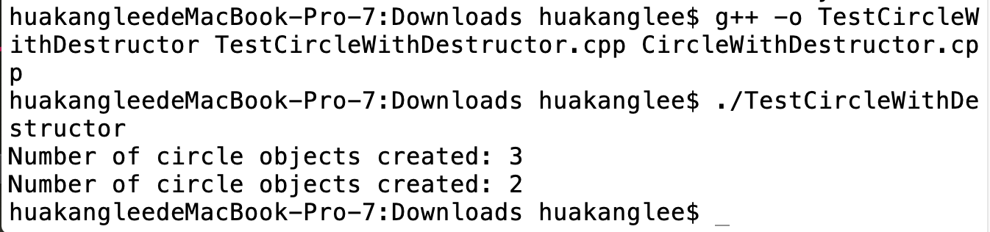
TestCircleWithDestructor.cpp
#include <iostream>
#include "CircleWithDestructor.h"
using namespace std;
int main()
{
Circle* pCircle1 = new Circle();
Circle* pCircle2 = new Circle();
Circle* pCircle3 = new Circle();
cout << "Number of circle objects created: "
<< Circle::getNumberOfObjects() << endl;
delete pCircle1;
cout << "Number of circle objects created: "
<< Circle::getNumberOfObjects() << endl;
return 0;
}

Slide 36
CircleWithDestructor.h
CircleWithDestructor.cpp
#include "CircleWithDestructor.h"
int Circle::numberOfObjects = 0;
// Construct a default circle object
Circle::Circle()
{
radius = 1;
numberOfObjects++;
}
// Construct a circle object
Circle::Circle(double radius)
{
this->radius = radius;
numberOfObjects++;
}
// Return the area of this circle
double Circle::getArea() const
{
return radius * radius * 3.14159;
}
// Return the radius of this circle
double Circle::getRadius() const
{
return radius;
}
// Set a new radius
void Circle::setRadius(double radius)
{
this->radius = (radius >= 0) ? radius : 0;
}
// Return the number of circle objects
int Circle::getNumberOfObjects()
{
return numberOfObjects;
}
// Destruct a circle object
Circle::~Circle()
{
numberOfObjects--;
}
#ifndef CIRCLE_H
#define CIRCLE_H
class Circle
{
public:
Circle();
Circle(double);
~Circle(); // Destructor
double getArea() const;
double getRadius() const;
void setRadius(double);
static int getNumberOfObjects();
private:
double radius;
static int numberOfObjects;
};
#endif

Slide 37
The Course Class

Slide 38
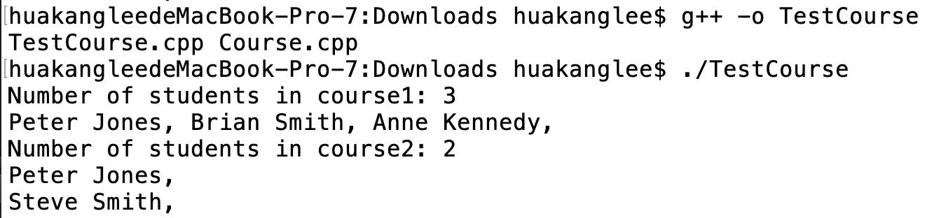
TestCourse.cpp
#include <iostream>
#include "Course.h"
using namespace std;
int main()
{
Course course1("Data Structures", 10);
Course course2("Database Systems", 15);
course1.addStudent("Peter Jones");
course1.addStudent("Brian Smith");
course1.addStudent("Anne Kennedy");
course2.addStudent("Peter Jones");
course2.addStudent("Steve Smith");
cout << "Number of students in course1: " <<
course1.getNumberOfStudents() << "\n";
string* students = course1.getStudents();
for (int i = 0; i < course1.getNumberOfStudents(); i++)
cout << students[i] << ", ";
cout << "\nNumber of students in course2: "
<< course2.getNumberOfStudents() << "\n";
students = course2.getStudents();
for (int i = 0; i < course2.getNumberOfStudents(); i++)
cout << students[i] << ", ";
return 0;
}

Slide 39
Course.h
Course.cpp
#ifndef COURSE_H
#define COURSE_H
#include <string>
using namespace std;
class Course
{
public:
Course(const string& courseName, int capacity);
~Course();
string getCourseName() const;
void addStudent(const string& name);
void dropStudent(const string& name);
string* getStudents() const;
int getNumberOfStudents() const;
private:
string courseName;
string* students;
int numberOfStudents;
int capacity;
};
#endif
#include <iostream>
#include "Course.h"
using namespace std;
Course::Course(const string& courseName, int capacity){
numberOfStudents = 0;
this->courseName = courseName;
this->capacity = capacity;
students = new string[capacity];
}
Course::~Course(){
delete [] students;
}
string Course::getCourseName() const{
return courseName;
}
void Course::addStudent(const string& name){
tudents[numberOfStudents] = name;
numberOfStudents++;
}
void Course::dropStudent(const string& name){
// Left as an exercise
}
string* Course::getStudents() const{
return students;
}
int Course::getNumberOfStudents() const{
return numberOfStudents;
}

Slide 40
Copy Constructor
Each class may define several overloaded constructors and one destructor. Additionally, every class has a copy constructor. The signature of the copy constructor is:
ClassName(const ClassName&)
For example, the copy constructor for the Circle class is
Circle(const Circle&)
The copy constructor can be used to create an object initialized with another object’s data. By default, the copy constructor simply copies each data field in one object to its counterpart in the other object.

Slide 41
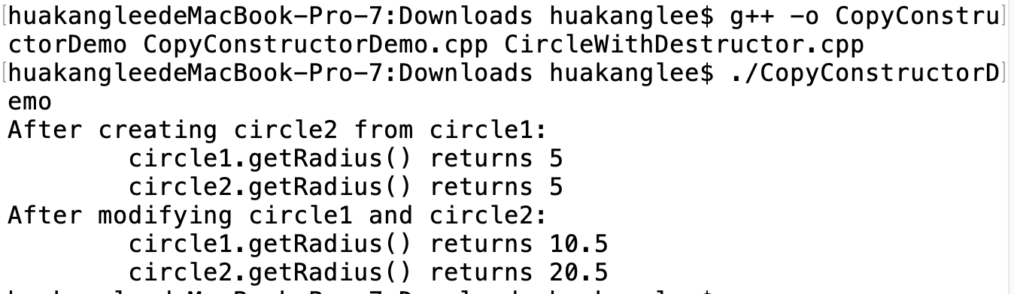
CopyConstructorDemo.cpp
#include <iostream>
#include "CircleWithDestructor.h" // Defined in Listing 11.11
using namespace std;
int main()
{
Circle circle1(5);
Circle circle2(circle1); // Use copy constructor
cout << "After creating circle2 from circle1:" << endl;
cout << "\tcircle1.getRadius() returns "
<< circle1.getRadius() << endl;
cout << "\tcircle2.getRadius() returns "
<< circle2.getRadius() << endl;
circle1.setRadius(10.5);
circle2.setRadius(20.5);
cout << "After modifying circle1 and circle2: " << endl;
cout << "\tcircle1.getRadius() returns "
<< circle1.getRadius() << endl;
cout << "\tcircle2.getRadius() returns "
<< circle2.getRadius() << endl;
return 0;
}

Slide 42
Shallow Copy vs. Deep Copy
The default copy constructor or assignment operator for copying objects performs a shallow copy, rather than a deep copy, meaning that if the field is a pointer to some object, the address of the pointer is copied rather than its contents.

Slide 43
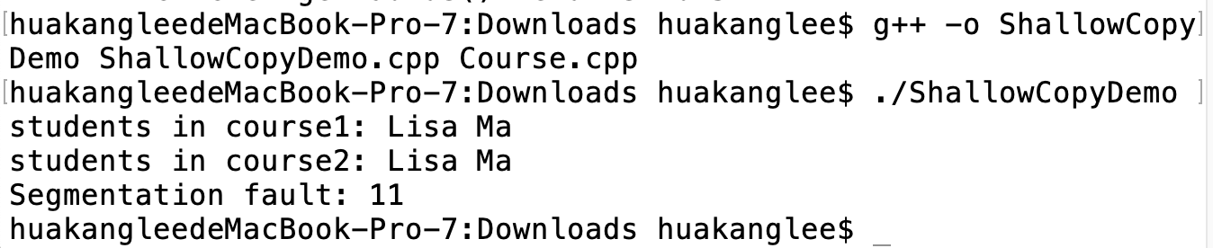
ShallowCopyDemo.cpp
#include <iostream>
#include "Course.h" // Defined in Listing 11.14
using namespace std;
int main()
{
Course course1("C++ Programming", 10);
Course course2(course1);
course1.addStudent("Peter Pan"); // Add a student to course1
course2.addStudent("Lisa Ma"); // Add a student to course2
cout << "students in course1: " <<
course1.getStudents()[0] << endl;
cout << "students in course2: " <<
course2.getStudents()[0] << endl;
return 0;
}

Slide 44
Shallow Copy
Copy course1 to course2. After copying course1 to course2, both course1 and course2 point to the same student.

Slide 45
Deep Copy
After course1 is copied to course2, the students data field of course1 and course2 point to two different arrays.

Slide 46
CourseWithCustomCopyConstructor.h
#ifndef COURSE_H
#define COURSE_H
#include <string>
using namespace std;
class Course
{
public:
Course(const string& courseName, int capacity);
~Course(); // Destructor
Course(const Course&); // Copy constructor
string getCourseName() const;
void addStudent(const string& name);
void dropStudent(const string& name);
string* getStudents() const;
int getNumberOfStudents() const;
private:
string courseName;
string* students;
int numberOfStudents;
int capacity;
};
#endif
ToDo
CourseWithCustomCopyConstructor.cpp
CustomCopyConstructorDemo.cpp

Slide 47
summarization
Pointer Definition
Pointer Type
Assignment Effect
Array Pointer
Const Parameter
Dynamic Memory
Constructor Copy

Slide 48



THANK YOU
Visit us
FOLLOW us
www.xjtlu.edu.cn
Notes:
Title: Uppercase, Calibri size 60, XJTLU Navy

